Slide 1
Azure Kubernetes Service (AKS)
Security
Module X

Slide 2
Conditions and terms of use
© Microsoft Corporation. All rights reserved.
You may use these training materials solely for your personal internal reference and non-commercial purposes. You may not distribute, transmit, resell or otherwise make these training materials available to any other person or party without express permission from Microsoft Corporation. URL’s or other internet website references in the training materials may change without notice. Unless otherwise noted, any companies, organizations, domain names, e-mail addresses, people, places and events depicted in the training materials are for illustration only and are fictitious. No real association is intended or inferred. THESE TRAINING MATERIALS ARE PROVIDED “AS IS”; MICROSOFT MAKES NO WARRANTIES, EXPRESS OR IMPLIED IN THESE TRAINING MATERIALS¹

Slide 3

Learning Units covered in this Module
 | Core Kubernetes Security Concepts
 | Security options for running Kubernetes on Azure

Slide 4
Core Kubernetes Security Concepts

Slide 5
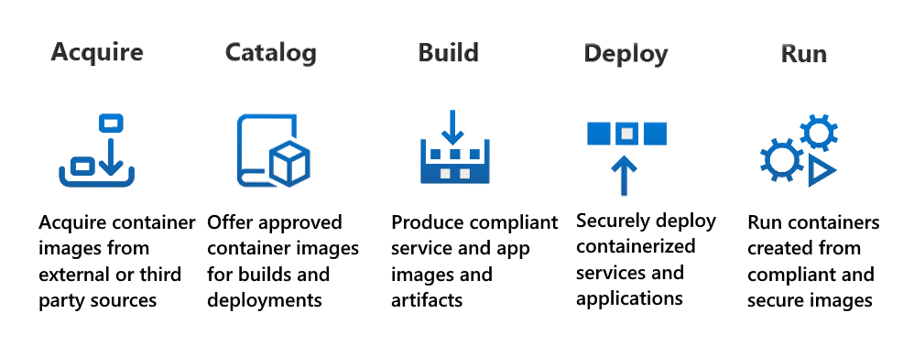
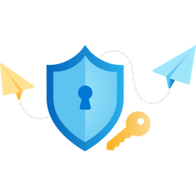
Secure all the things!!
Consider the following five attack surfaces when you create a security strategy for Kubernetes clusters:
Build
Registry
Cluster
Node
Application
CAF
CSSC
Notes:
The Cloud Adoption Framework (CAF) talk about :
Build, Registry, Cluster, Node, Application
https://learn.microsoft.com/en-us/azure/cloud-adoption-framework/scenarios/app-platform/aks/security
And the Containers Secure Supply Chain (CSSC) :
Acquire Acquire container images from external sources or third-party vendors.
Catalog Offer approved container images for internal consumption including builds and deployments.
Build Produce compliant service and application images and deployment artifacts.
Deploy Securely deploy containerized services and applications to the hosting environments.
Run Run containers created from compliant, latest, and secure container images executing the business logic for an application.
https://learn.microsoft.com/en-us/azure/security/container-secure-supply-chain/articles/container-secure-supply-chain-implementation/containers-secure-supply-chain-overview
In fact, both framework talk about the same, one more theorical, the second more practical.
Explain that on this module we will focus on the Containers Secure Supply Chain (CSSC), but customers should use the Cloud Adoption Framework as guideline for development decisions.

Slide 6





Containers Secure Supply Chain (CSSC) Framework
Acquire
Catalog
Build
Deploy
Run
Container
Image
Acquire cloud native
artifacts from external sources
and ensure min
quality bar.
Offer a curated catalog of cloud native artifacts
for internal use; constantly update and refresh
the catalog.
Build cloud native artifacts in a consistent and secure manner; include security controls
and keep them always up to date.
Deploy cloud native artifacts using
company-wide policies for
compliance; prevent non-compliant artifacts reaching
the runtime
environment.
Constantly monitor
the runtime environment;
keep it clean from vulnerable and
non-compliant artifacts.
https://aka.ms/csscframework
Notes:
Don’t explain everything, we will cover each topic on the next slides.
The goal here is to explain the first T :
T-T-T
Tell them what you're going to tell them
Tell them the content
Tell them what you told them
1min max, talk about the link on the bottom

Slide 7
Acquire Stage

Slide 8



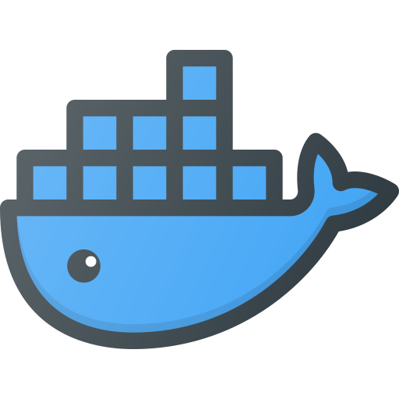






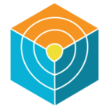
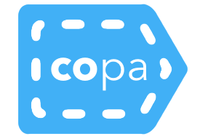
Acquire Stage
Quarantine
ACR
Catalog Stage
Project QUAY
Establish a min quality bar for artifacts acquired from external sources.
Curate content
Verify sources
Scan for vulnerabilities and malware
Generate SBOMs
Add provenance and lifecycle metadata
Docker Hub
Min quality
gate
GHCR
ECR Public
GCR
NVIDIA
Defender
Trivy
Copa
Notes:
Acquisition of external container images to use as base or utility images is the first stage of the supply chain for containers. Enterprises may lack the expertise or resources to build every piece of software from source and need to rely on external sources for container images.
Examples of such images are operating system or framework images, service proxies like NGINX and Envoy, or logging and metrics images like Fluentd and Kafka. It is important to establish certain quality checks before use and ensure that such images comply with the enterprise policies.
Risks
Container Running at Higher privileges
Access to the underlying host file system
Rogue containers
Images from untrusted sources
Solving those risks
Addressing them during build vs later down the chain
Container linting tools like docker scan docker files for best practices and find underlying security issues
Scanning the image during the build phase before pushing it remotely
Knowing all of the layers of a container image, application dependencies and custom pieces
Appropriate policies can help set quality gates at this level

Slide 9
Catalog Stage

Slide 10
Catalog Stage
Catalog
ACR
Use a “golden registry” for internal needs.
Offer only trusted and supported images
Continuously scan for vulnerabilities and malware
Keep artifact metadata up-to date
Min quality
gate
Pre-build
gate
Defender
Trivy
Copa
Notes:
Building a Catalog of container images for internal use is the second stage of the supply chain for containers. Container images that pass certain quality checks from the Acquire stage are hosted in an internal registry
It is essential to catalog container images so internal teams can easily discover and consume approved images required by enterprise applications and services
Additionally, container images in a catalog are continuously scanned for vulnerabilities and malware on a regular basis to ensure they meet the latest security requirements
Preventing images from being pushed and pulled from unauthorized locations
Internal only

Slide 11
Build Stage

Slide 12

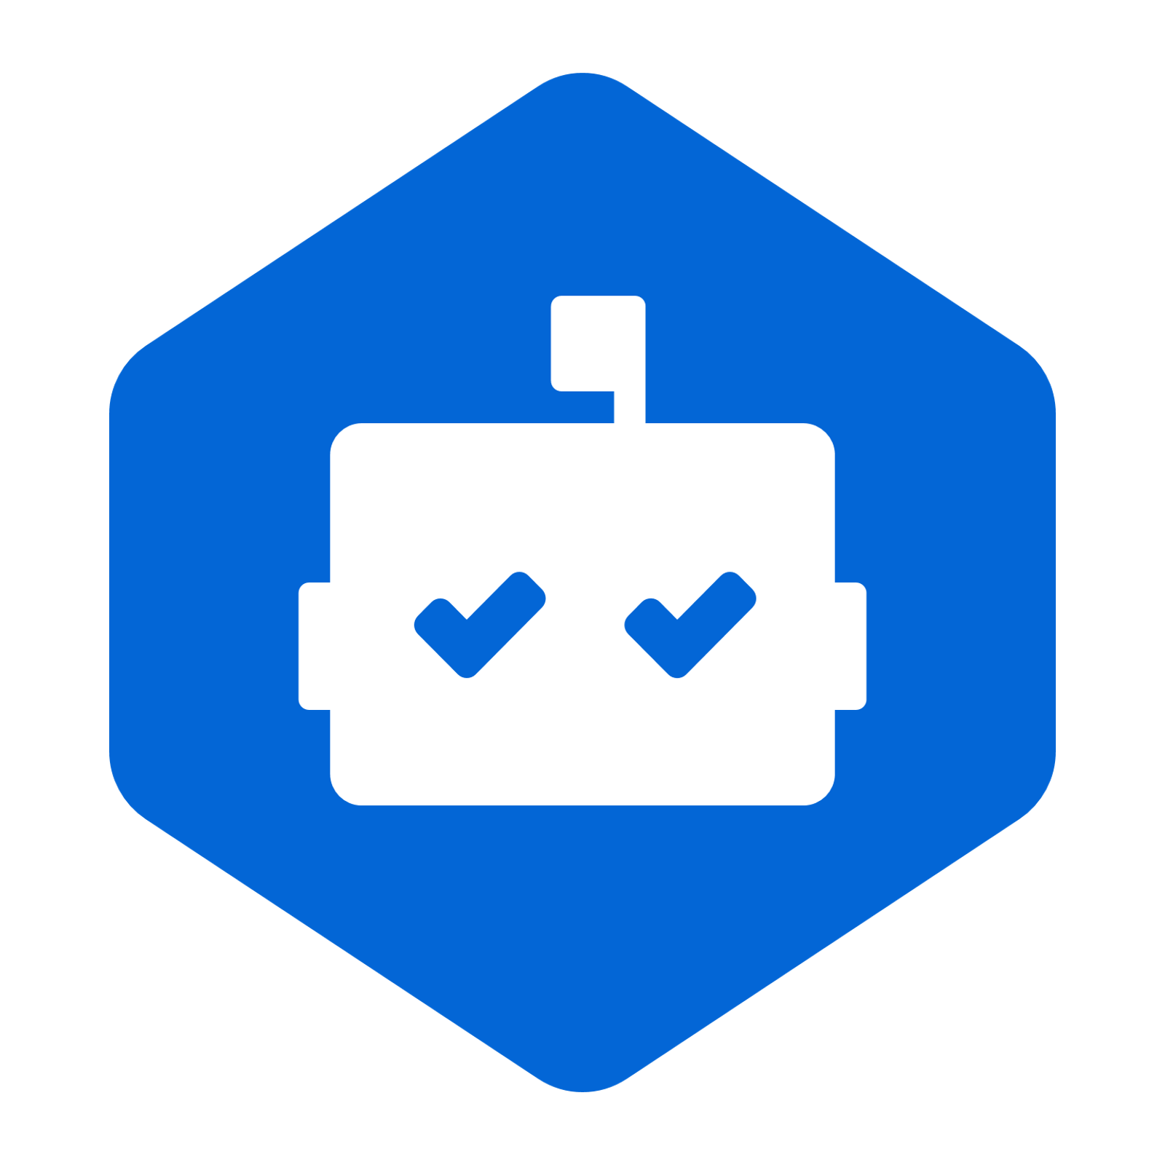
Build Stage
Github
ADO
Build app images in a consistent
and secure way.
Use trusted images only
Verify lifecycle and provenance metadata
Scan after build
Fix known vulnerabilities during/post build
Sign images and artifacts
Pre-build
gate
Post-build
gate
Github
Azure DevOps
Defender
Dependabot
Copa
Notes:
While some enterprises pull the base images from external sources directly, others may pull the base images from the internal catalog without verifying the images against their signatures and attestations.
It is crucial to ensure that base images are always pulled from the internal catalog and verified before use.
It is essential to ensure that the produced container images are trusted and compliant with the enterprise policies.
Stale images
Should be removed to avoid accidental deployment
Avoid using latest tags for images!
Preventing images from being pushed and pulled from unauthorized locations
Internal only
Insufficient controls around pulling images
Ci/CD pipelines should only push images after going through appropriate quality gates
Registries now contain much more than container images
Signing Images
Only way to ensure images are being deployed from trusted registries

Slide 13
Deploy Stage

Slide 14

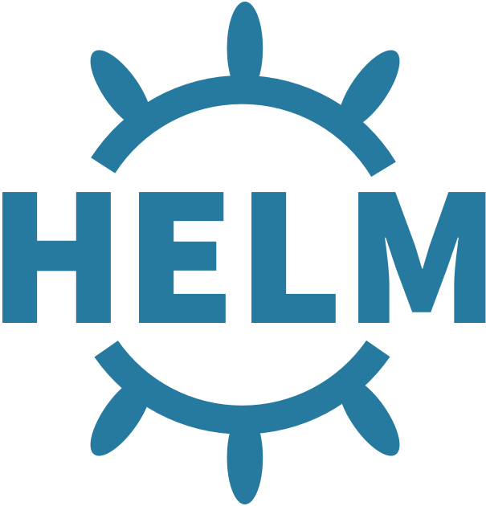
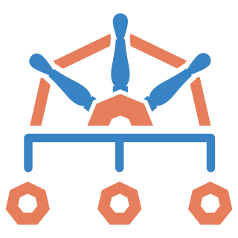

Deploy Stage
Deploy
ACR
Connected
Registry
Prevent non-compliant artifacts reaching the runtime environment.
Continuously scan for vulnerabilities and malware
Keep artifact metadata up-to date
Enforce deployment policies
Post-build
gate
Deployment
gate
Helm
Defender
Trivy
Copa
Kyverno
Gatekeeper
Notes:
Enterprises might deploy container images to their hosting environment to run containerized workloads without validating the security and compliance of those container images.
This increases the potential security risks or may result in running vulnerable or malicious code in the hosting environment.
The container image metadata and attestations produced in previous stages should be validated at deployment time. This ensures that the deployment complies with enterprise-wide security and compliance policies.
Having solutions on the cluster to scan for vulnerable components (Defender)
Azure policy can assist with some options to enforce standards
Kyverno or Gatekeeper is another piece that can enforce polices
Gatekeeper requires using a separate language (rego) to create polices that control workload behavior
Kyverno
Works differently from Gatekeeper
K8s native policy engine
Define and mange polices as Kubernetes resources
Can deploy polices as individual yaml files or package and deploy as helm charts
Unlike gatekeeper it can generate new objects on the cluster not just validation
Ex: create a new network policy for new namespaces, etc
https://kyverno.io/docs/introduction/#quick-start-guides

Slide 15
Run Stage

Slide 16




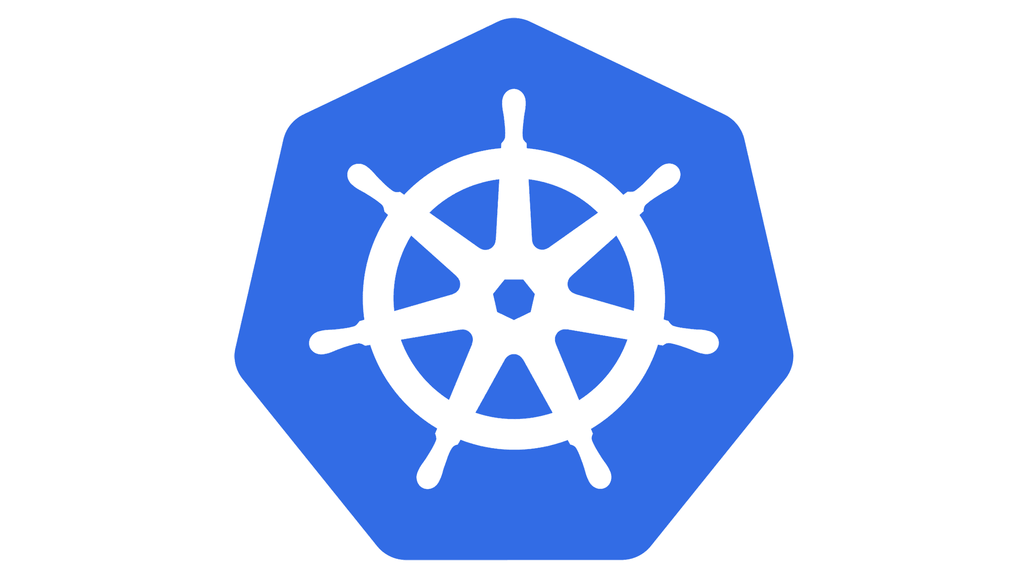
Run Stage
AKS
Arc
Monitor and keep runtime environments clean and secure.
Monitor for abnormal activity
Continuously scan for vulnerabilities and malware
Keep runtime nodes clean
Deployment
gate
Defender
Gatekeeper
Ratify
Azure Policy
Kubernetes
Kyverno
Notes:
This stage emphasizes scanning and monitoring the runtime environments and purging them of outdated and vulnerable images.
Microsoft recommends continuously running vulnerability and malware scanner for containerized workloads and runtime
Regularly updating the containers and the nodes as well as keeping the nodes clean are effective practices to protect containerized applications from compromising.

Slide 17



Authenticity & Integrity
Acquire
Catalog
Build
Deploy
Run
Container
Image
Verify external signatures and sign acquired artifacts with an internal key.
Verify the internal signature before publishing; sign updated metadata with internal keys.
Verify the internal signature before build; sign new artifacts and metadata with internal keys.
Verify the internal signature before deployment; sign updated metadata with internal keys.
Evict artifacts that have compromised authenticity and integrity.
Notes:
This is a high level, you can explain briefly each column

Slide 18


Observability
Acquire
Catalog
Build
Deploy
Run
Container
Image
Create attestations for source location, license check, vulnerability and malware scan. Add SBOM if missing.
Create attestations for vulnerability and malware scans. Attest for end-of-life and updates.
Create provenance and SBOMs. Attest for vulnerability and malware scans.
Attest for deployment and policy validations.
Create scan attestations and eviction attestation.
Notes:
This is a high level, you can explain briefly each column
During labs we will check how to apply those concepts using Microsoft tools to ensure security

Slide 19
Security Options for AKS

Slide 20
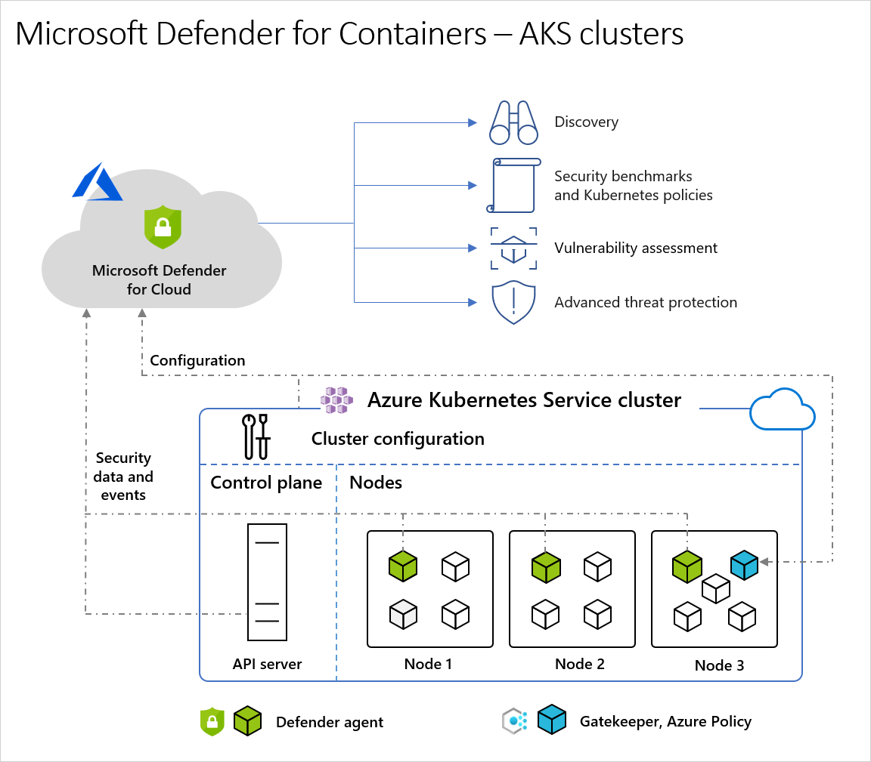
Defender for Containers
Protects four core domains of Container Security
  Security Posture Management
  Vulnerability Assessment
  Run-time threat Protection
  Deployment and Monitoring
Agentless deployment
Works on any Kubernetes cluster
Use the AKS Security Dashboard (Preview) to gain a comprehensive overview and automated remediation of security issues
Notes:
This is a high level, you can explain briefly each column
During labs we will check how to apply those concepts using Microsoft tools to ensure security

Slide 21
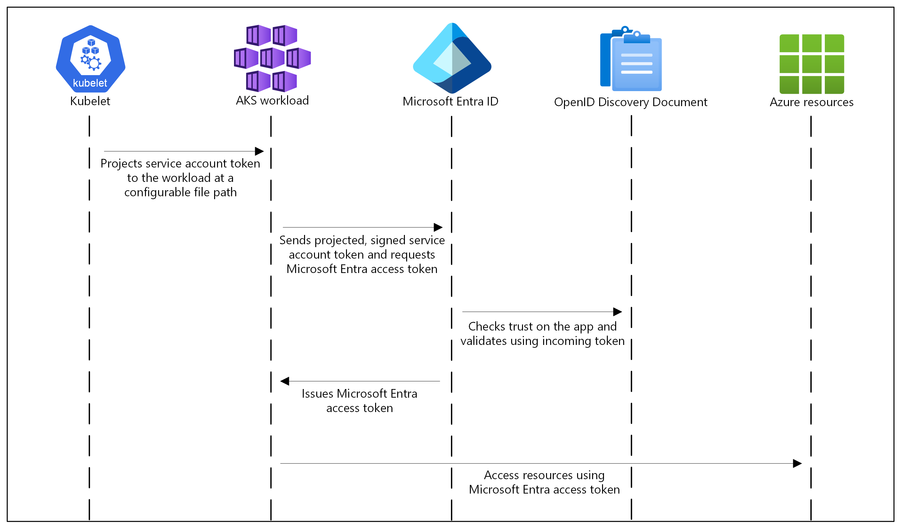
Workload Identity
Enables pods to use Kubernetes identity and securely access Azure resources that they are authorized.
Limitations
  Max 20 federated credentials per managed identity
  Virtual nodes addon is not supported
  Select regions do not support user assigned MI
Notes:
How it works:
In this security model, the AKS cluster acts as the token issuer. Microsoft Entra ID uses OpenID Connect to discover public signing keys and verify the authenticity of the service account token before exchanging it for a Microsoft Entra token. Your workload can exchange a service account token projected to its volume for a Microsoft Entra token using the Azure Identity client library or the Microsoft Authentication Library (MSAL).

Slide 22
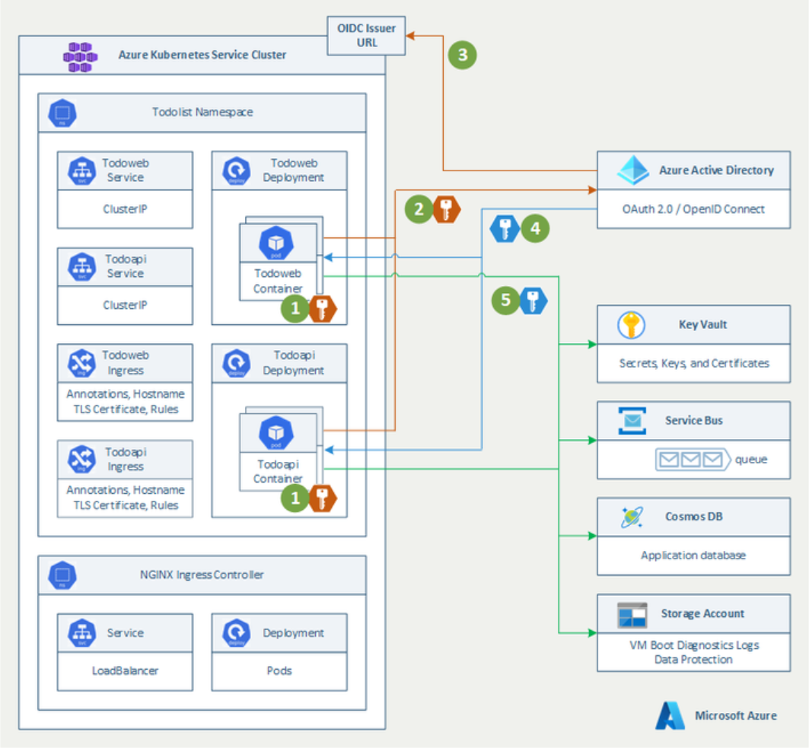
Walkthrough
Notes:
1 AKS issue a token to the pod when it is schedule on a node and based manifest
2 When Pod need access to resource then it send the AKS token and send that to Entra to request a token to a resource
3 Entra then check the trust and validate the incoming token with the federate identity
4 AD issue a token for the resource
5 And Pod can use the token to access the resource

Slide 23
ACR Continuous patching
Automatic detection and remediation of OS vulernabilities for Containers
  Trivy for Scans
  Copa for Applying fixes
Use Cases
  Enforcing Container security and Hygiene
  Speed of Use
Limitations
  Linux Only
  Does not patch Application packages ( Python, NodeJS, Go)
  EOSL Images are not supported
  Not compatible with ABAC (Attribute Based Access Control) enabled registries and with PTC (Pull Through Cache) enabled
  100 Image limit
Notes:
This is a high level, you can explain briefly each column
During labs we will check how to apply those concepts using Microsoft tools to ensure security

Slide 24
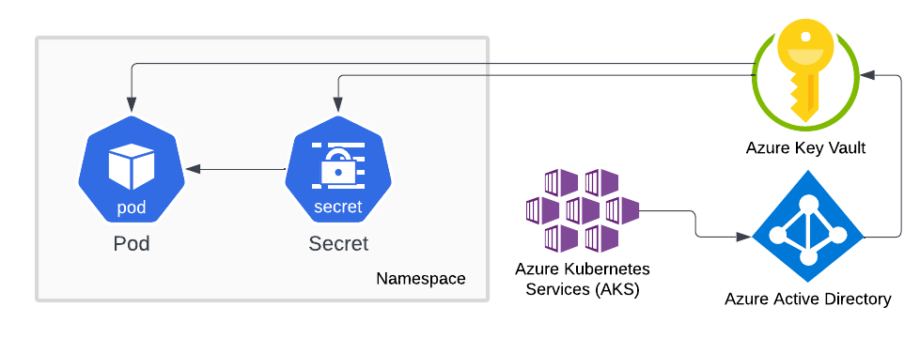
Azure Key Vault
Azure Key Vault is a cloud service for securely storing and accessing secrets.
A secret is anything that you want to tightly control access to, such as API keys, passwords, certificates, or cryptographic keys.
When you enable Azure Key Vault support in your AKS cluster, you’ll be able to automatically create Kubernetes Secrets in your cluster when you need them.
You also have the option of directly injecting sensitive content directly into containers, without creating Kubernetes Secrets first.

Slide 25
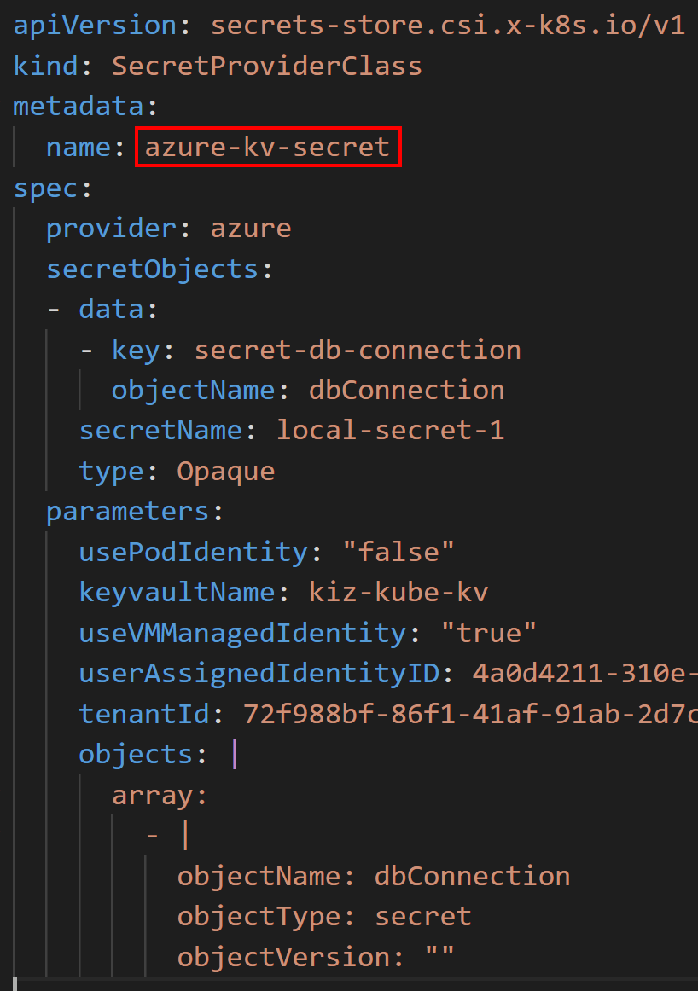
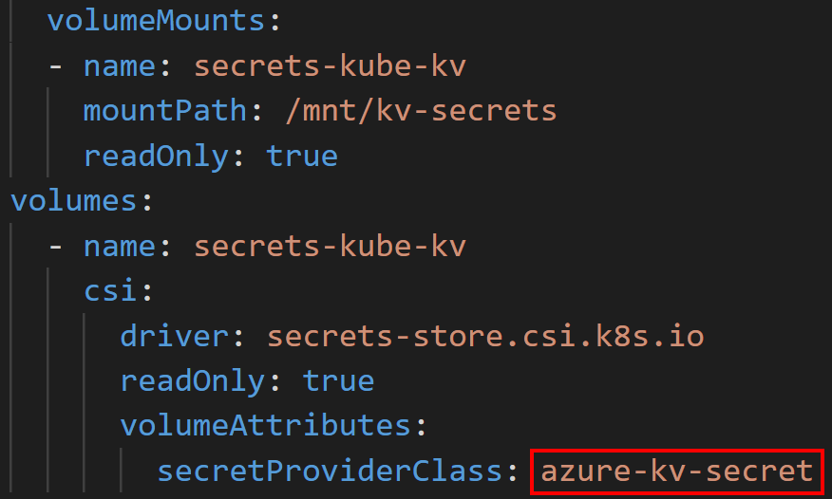
Azure Key Vault Integration
When Azure Key Vault is enabled in AKS, a custom resource called SecretProviderClass is available.
This manifest provides the connection information to Key Vault.
  The secretObjects section is optional and only used if you want to create a Kubernetes Secret object.
When a Pod mounts the Secrets CSI volume, the Key Vault secret(s) is injected into the container (and a Secret object is created if specified).
If a Secret object is created, it’s automatically deleted when the last Pod that accesses that Secret is deleted.

Slide 26
Open Source Options
Network Security Options
  Calico
  Cilium for Azure CNI Powered by Cilium Clusters (Recommended Option)
Service to Service traffic encryption
  Service mesh (Istio mTLS)
  Dapr (mTLS)\
Policy Engines
  Gatekeeper
  Kyverno
Notes:
While Calico can be used as a network security option it is NOT tested or supported by the AKS product group.
Cilium is tested and supported by the AKS PG and Azure support can assist with issues.
This link can help with explaining differences between the different policy engines Secure pod traffic with network policies - Azure Kubernetes Service | Microsoft Learn
Gatekeeper is already used by Azure Policy on AKS. Can use Gatekeepers community library and Rego to create polices
Kyverno is a similar policy engine, but it can control state and reapply Kubernetes objects on a cluster (ex: Someone deletes a limit range it can reapply it). Uses standard YAML templates.

Slide 27
Lab
Lab Description
Azure Keyvault
Acr Continuous Patching
Instructor workload Identity demo
Notes:
Workload identity Demo: Workload Identity | AKS LABS

